Slide 1
Lafayette Police Department - 2018 Annual Report

Slide 2
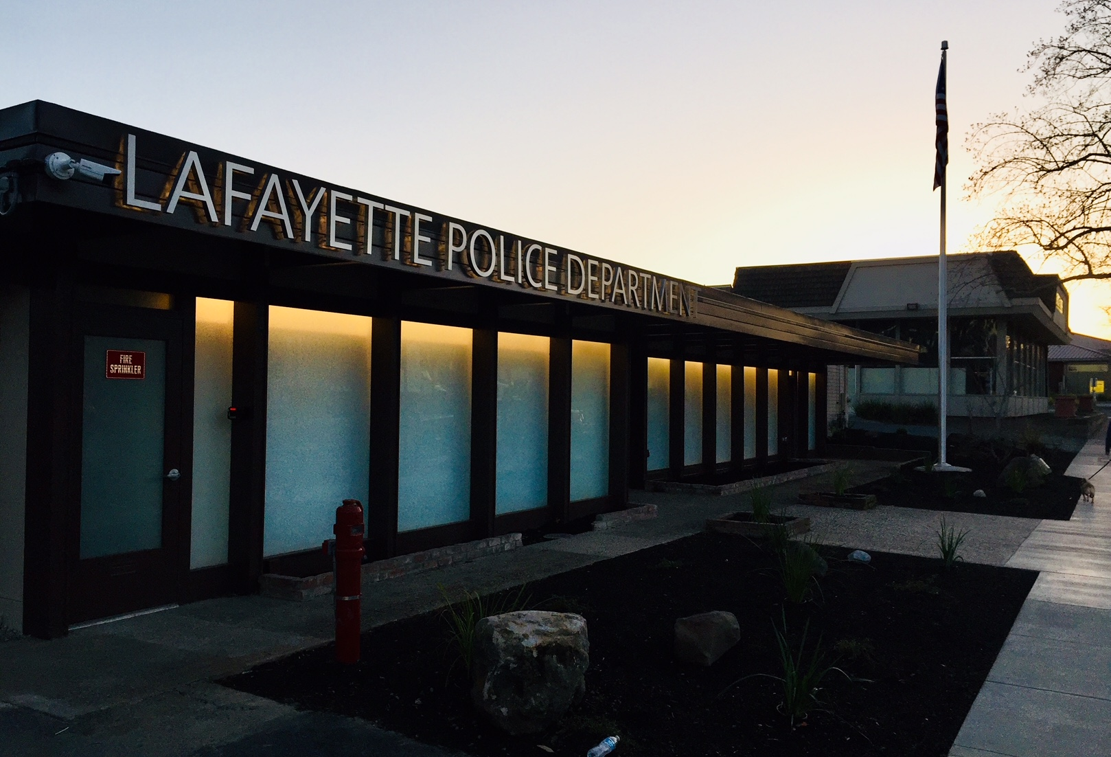
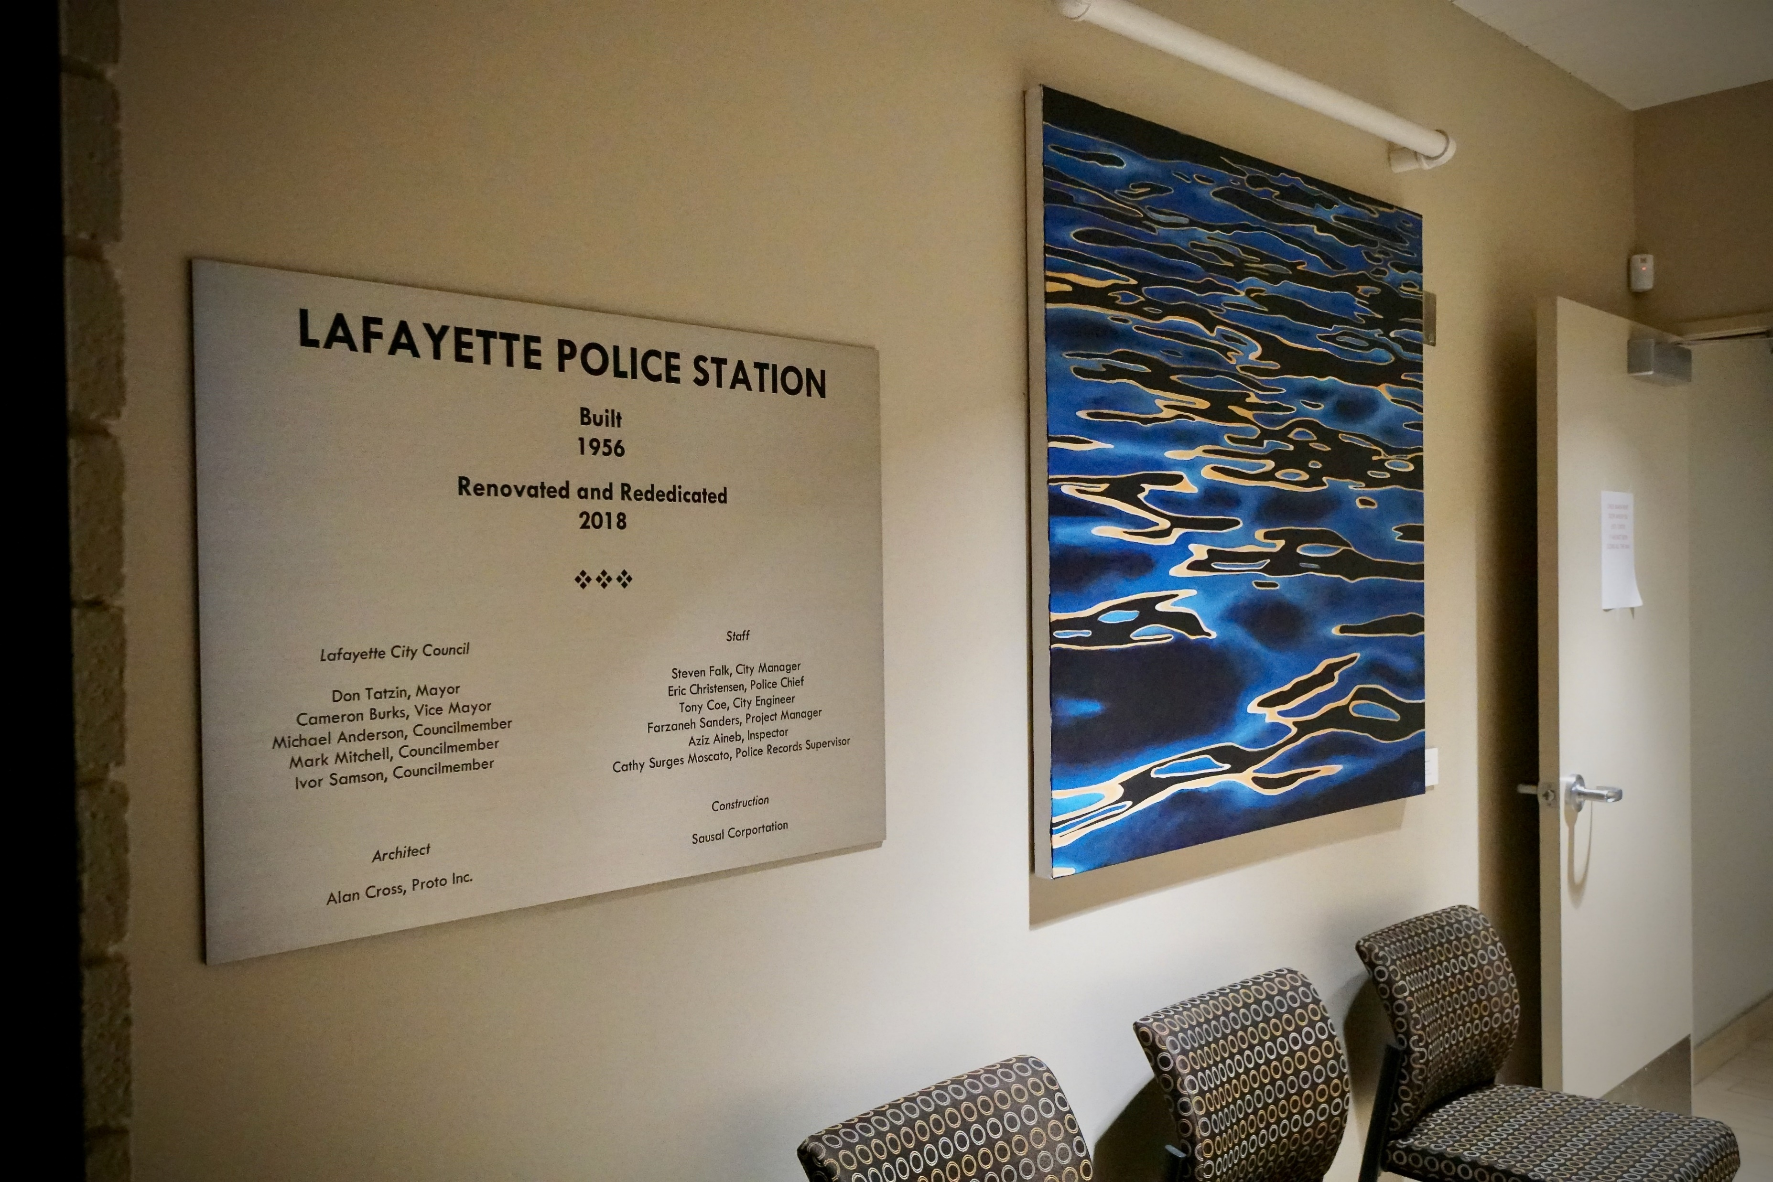
2018 Annual Report
New Lafayette Police Department Station

Slide 3
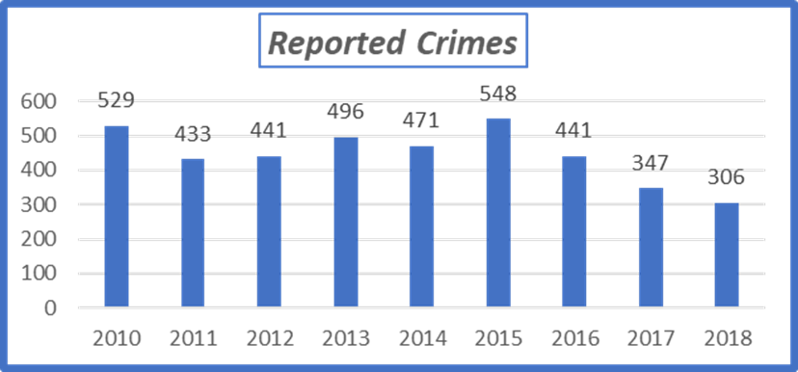
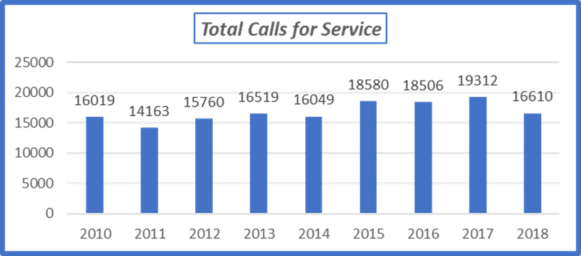
2018 Annual Report

Slide 4
2018 Annual Report
Person Crimes
Crimes against persons are the highest priority as they have the largest impact on the victim.
Lafayette 2018:
2 Assaults with Deadly Weapons
1 Attempted Kidnapping
6 Robberies
2 Felony Domestic Violence Cases
2 Assaults on Police Officer
2 Indecent Exposure Cases
(There were no reported rapes or child sexual assaults for all of 2018.)

Slide 5
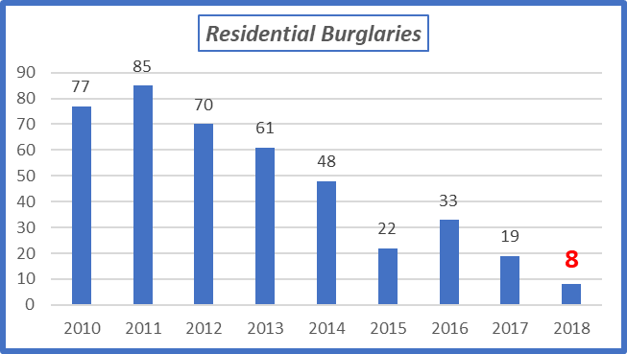
2018 Annual Report
Property Crimes
The largest number of crimes that occur within Lafayette are those that target items of property.
Residential Burglaries
8 Residential Burglaries -
7 Closed

Slide 6
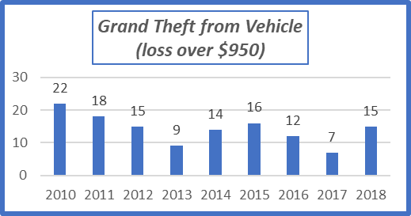
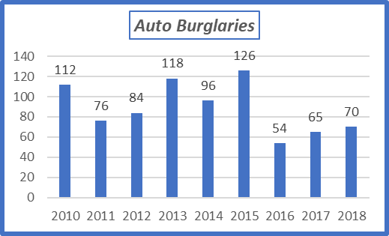
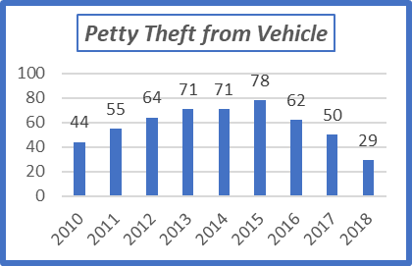
2018 Annual Report
Property Crimes

Slide 7
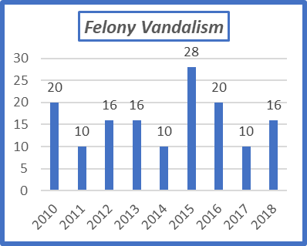
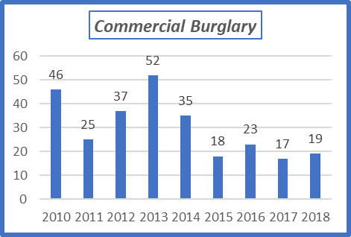
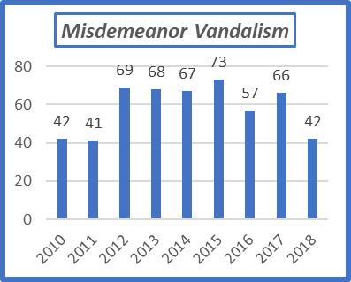
2018 Annual Report
Property Crimes

Slide 8
2018 Annual Report
Code Enforcement
In Lafayette, the Code Enforcement Unit is within the Lafayette Police Department.
In 2018, the Code Enforcement Unit handled 368 complaints from residents.
The top six calls for service:
Fire hazards & weed abatement
Property Maintenance
Inoperable vehicles and boats in public view
Construction without a permit
Tenant – Landlord – Neighbor disputes
Animals

Slide 9
2018 Annual Report
Crime Prevention Commission
In 2018, continued the mission of making Lafayette a safe community.
“Lock Up Lafayette”
“Don’t Feed the Bears”
Informational booths at Lafayette Safety Fair and Art & Wine Festival
2 Citizens Academies

Slide 10
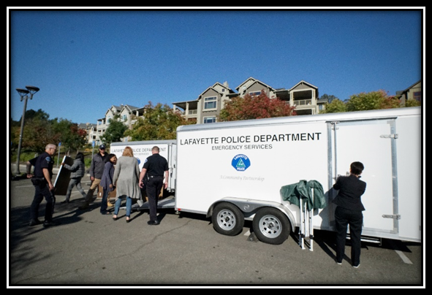
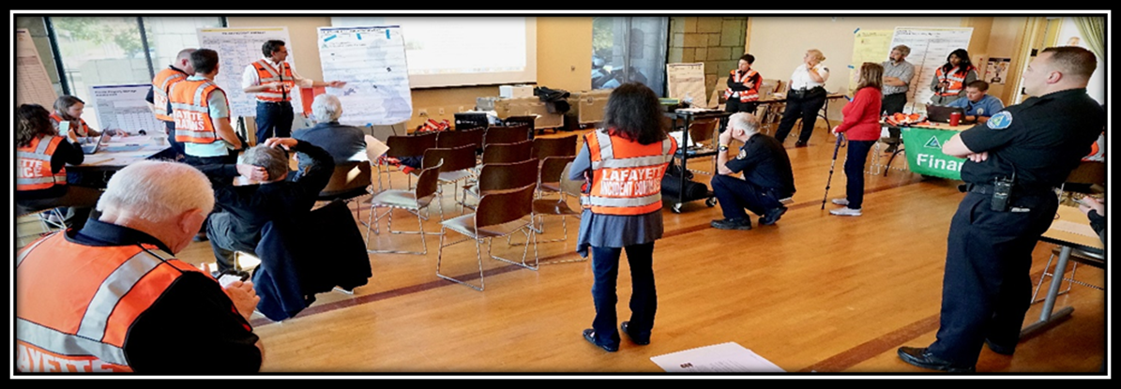
2018 Annual Report
Emergency Preparedness Commission
In 2018, continued the mission of prioritizing Lafayette’s
emergency plans and preparedness.
Great Shakeout Drill
Lamorinda Resident’s Guide to Wildfire Preparedness and Evacuation
Continually review/revise the City of Lafayette’s Emergency Operations Plan

Slide 11
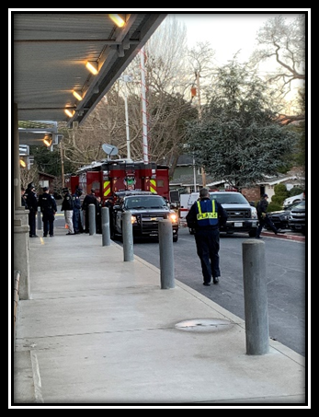
2018 Annual Report
School Safety
Conducted two drills this year, one at Bentley High School and
one at Stanley Middle School
Went from 3 Active Shooter Instructors to 7
ALERTT Conference
Increased our overall preparedness – medical equipment and additional command post vehicle

Slide 12
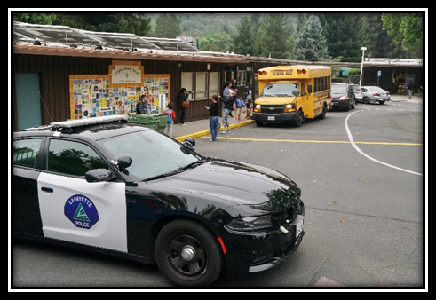
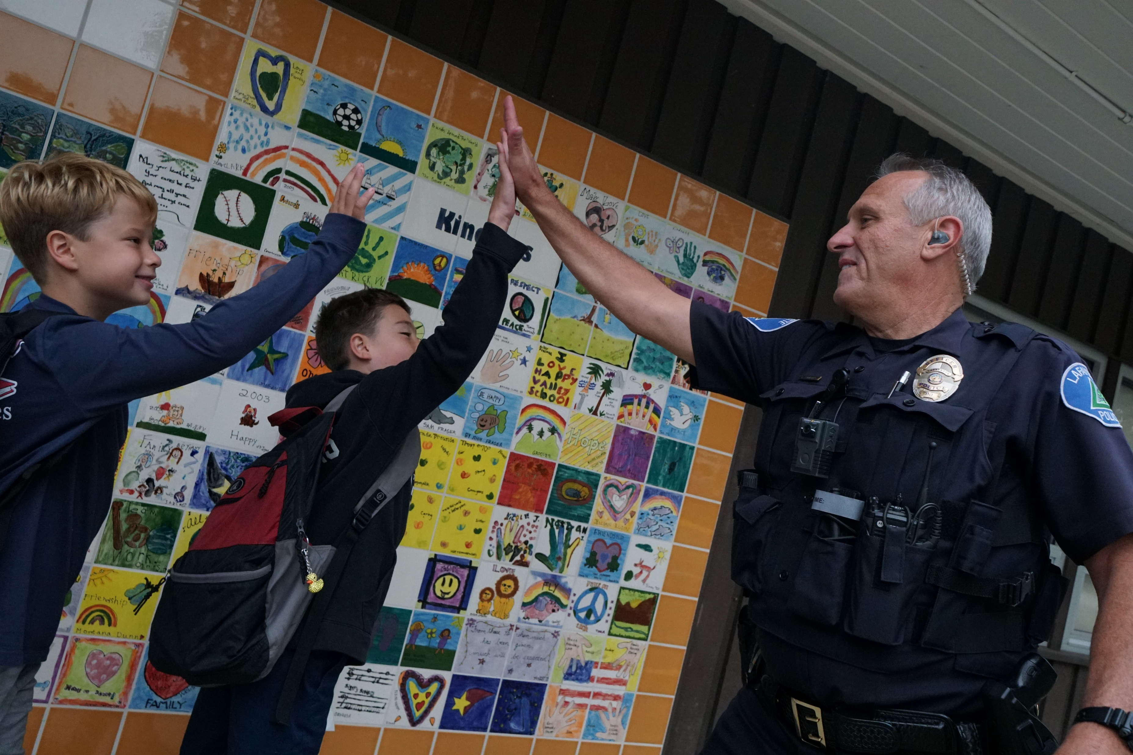
2018 Annual Report
School Safety
Training for School Staff – Stanley, Bentley, Acalanes
“Recess with a Police Officer”
Back to School Day

Slide 13
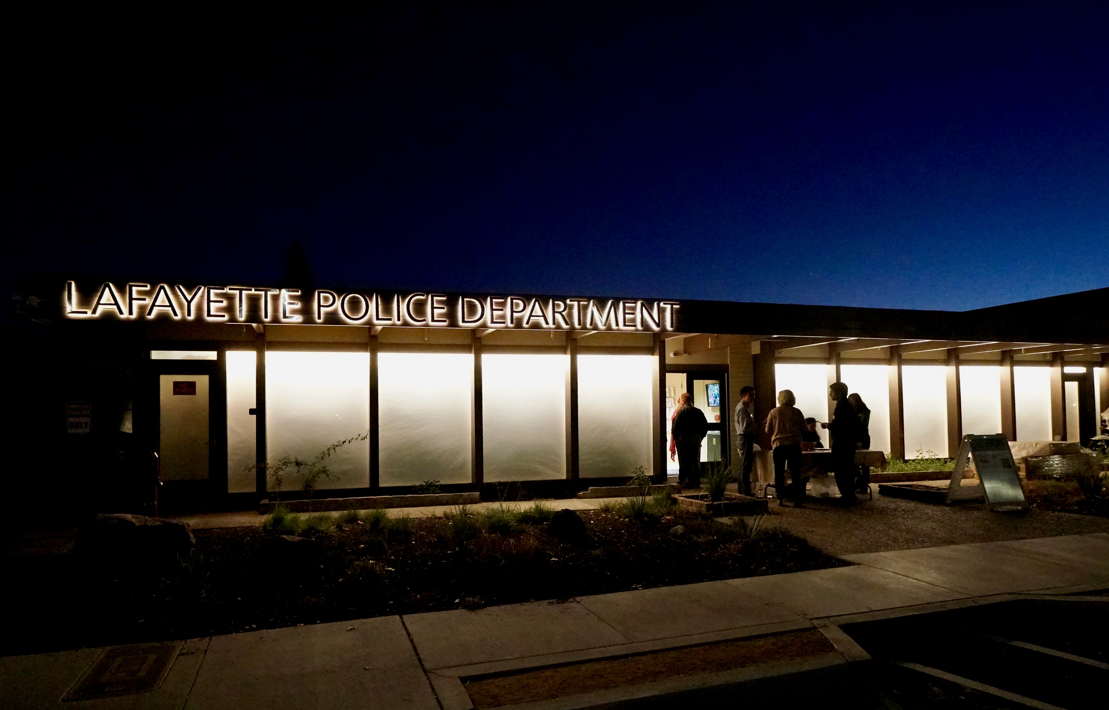
2018 Annual Report
Community Engagement
Active Threat Training – Lafayette Park Hotel & Lafayette Library
Candy Scramble, DogTown-DownTown, Rock the Plaza, Trick or Treat Streets
Lafayette 50th Anniversary
Art & Wine Festival
Res Run
Community Presentations
Several Open Houses and Tours at the
new Police Department Station

Slide 14
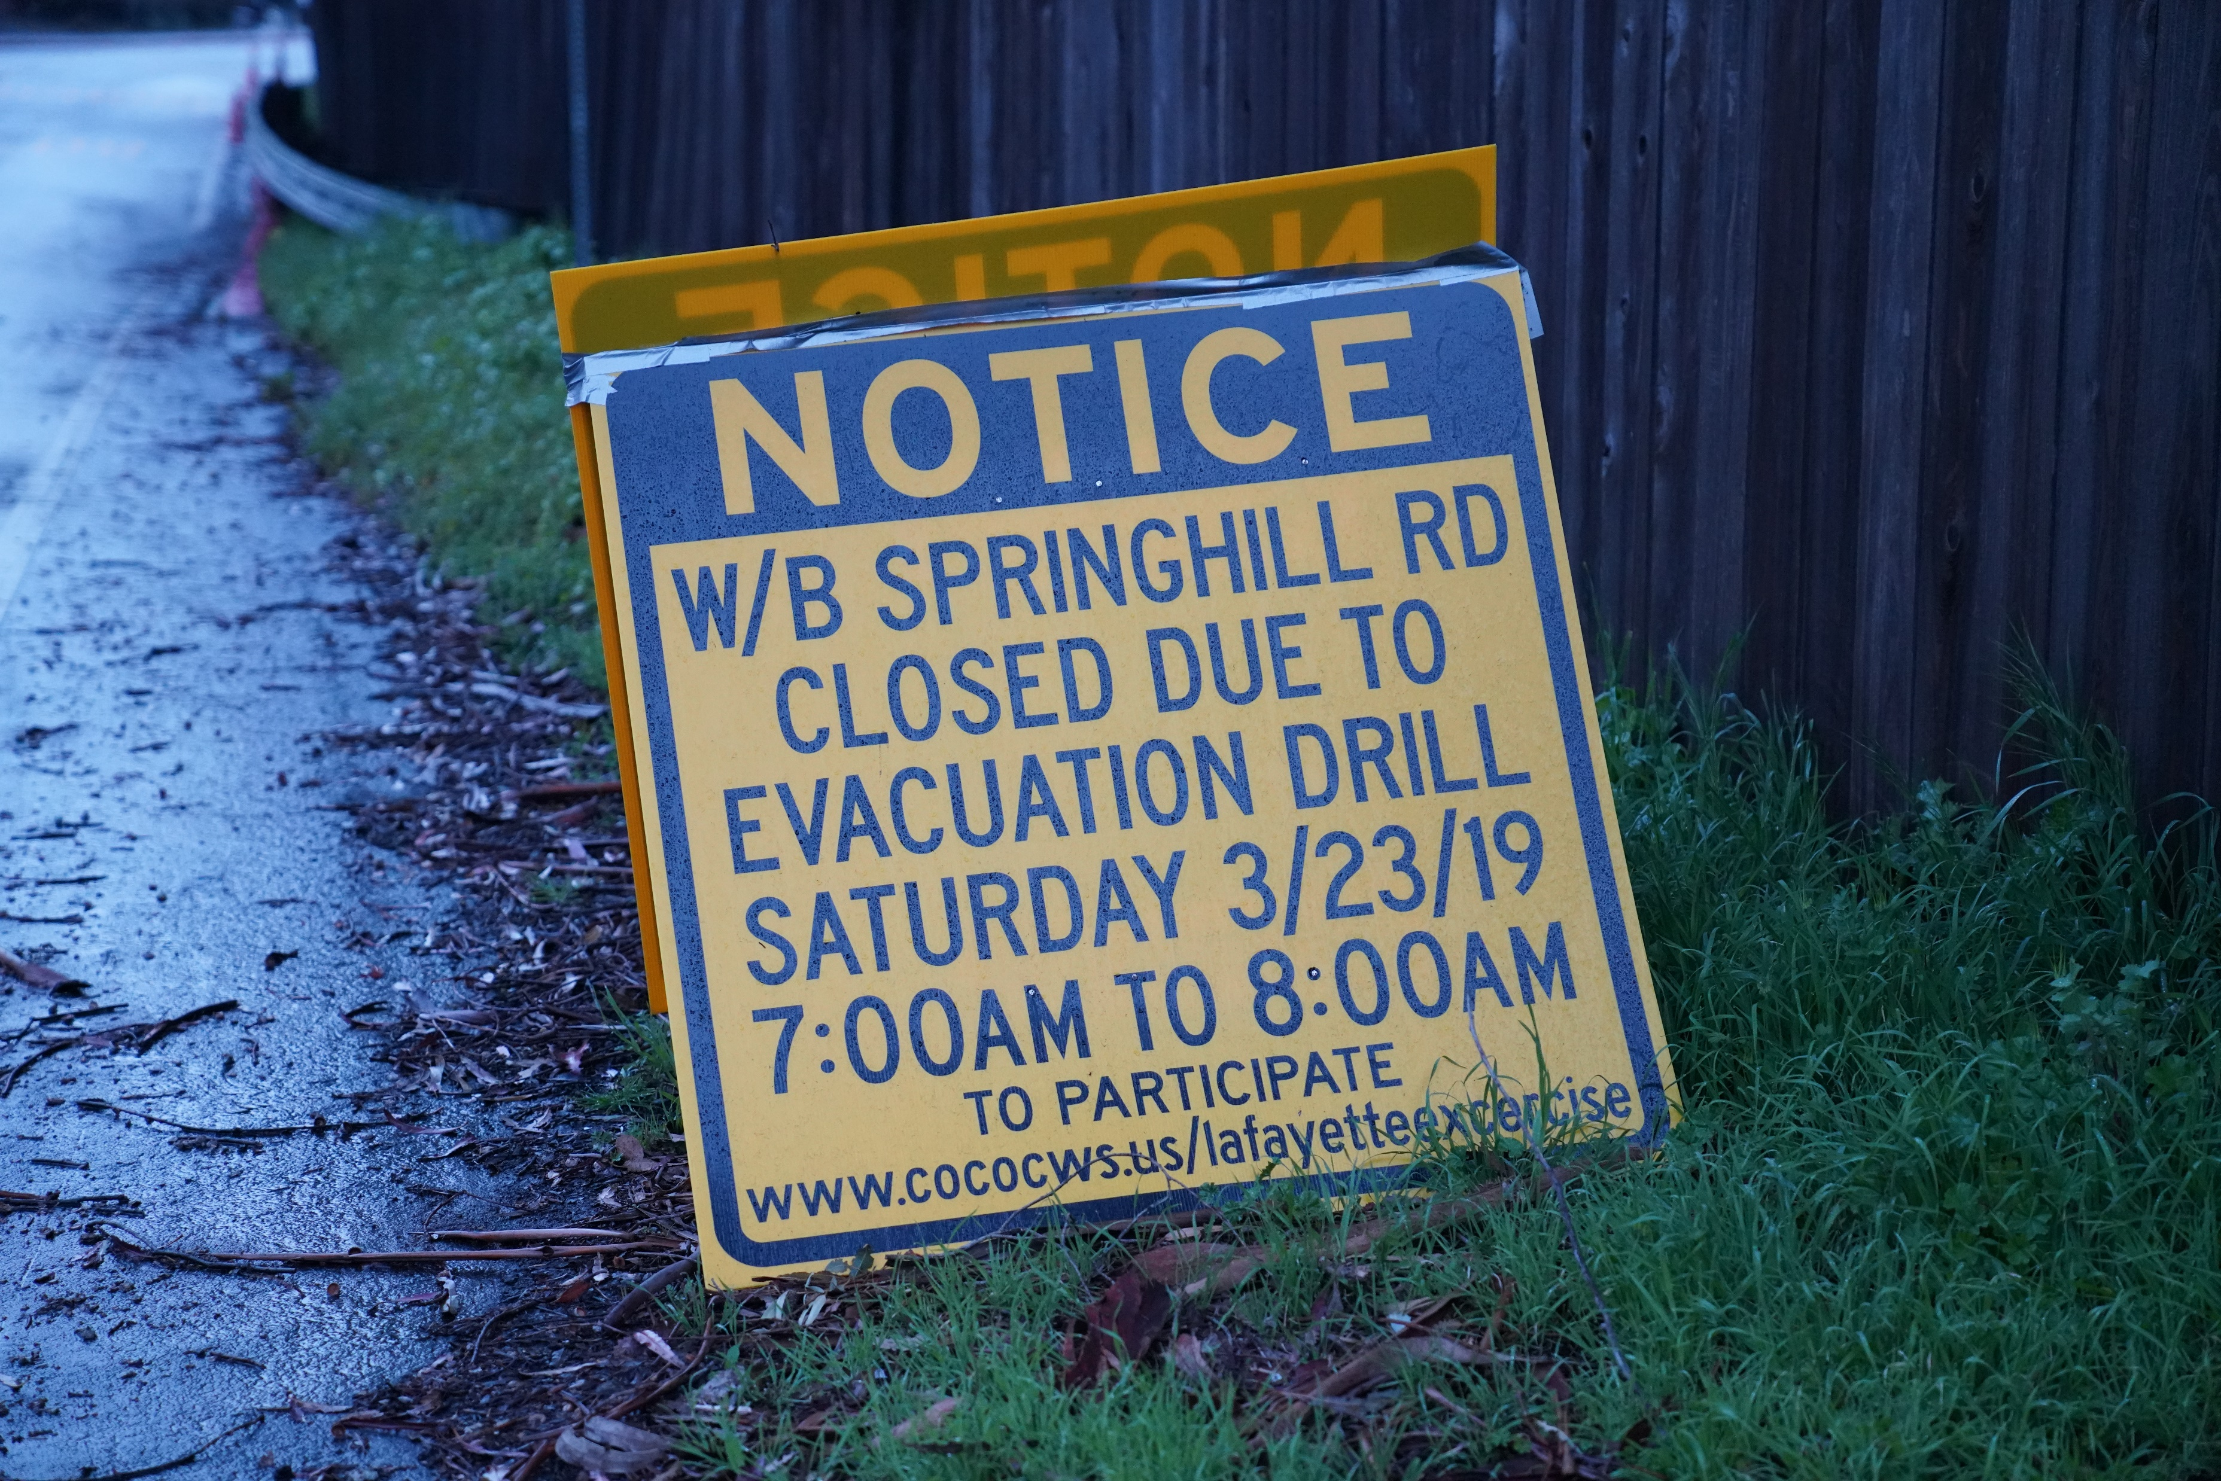
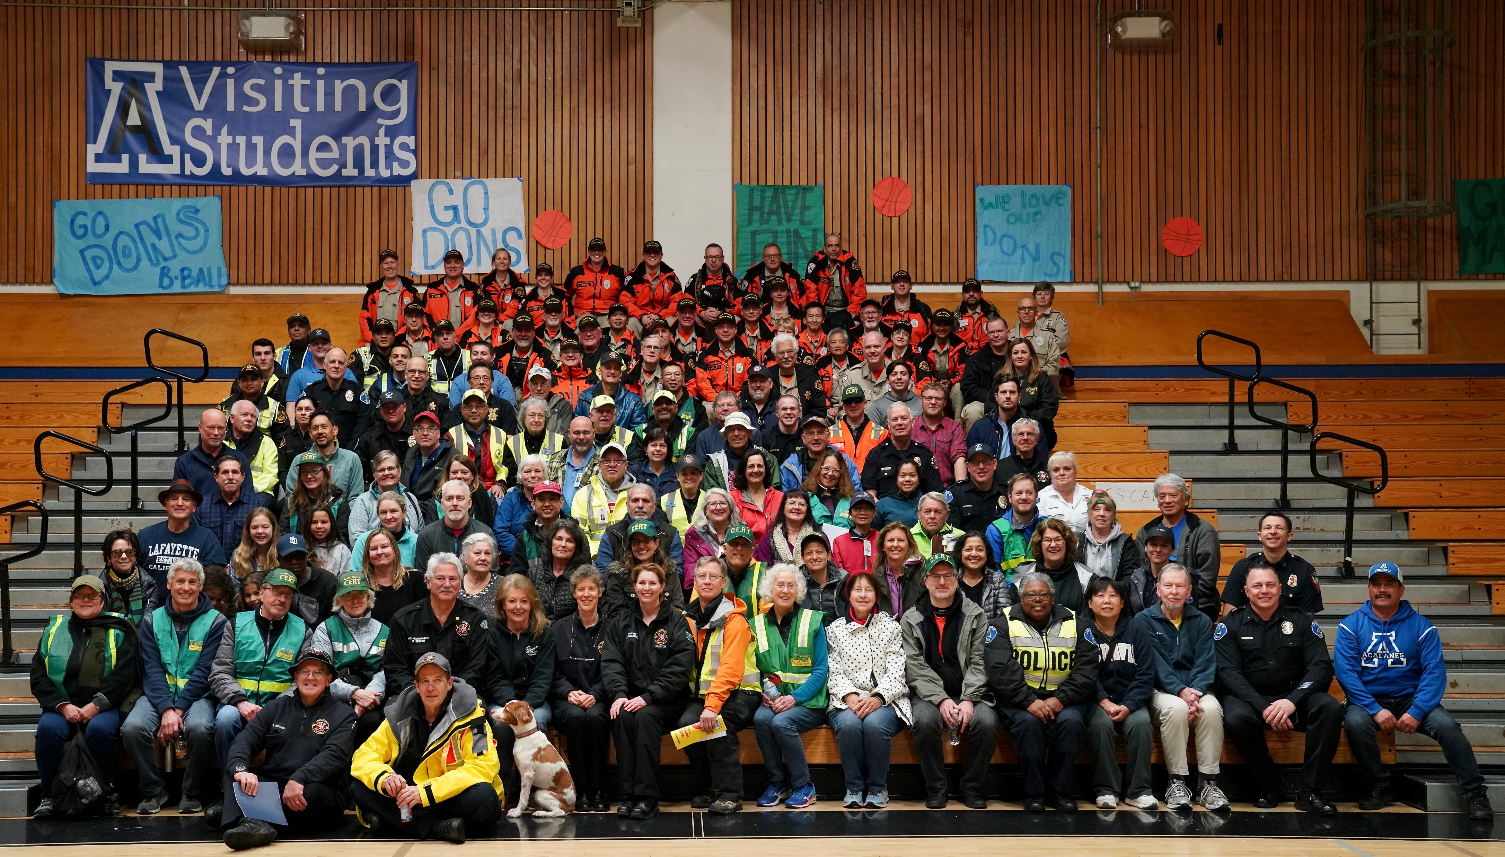
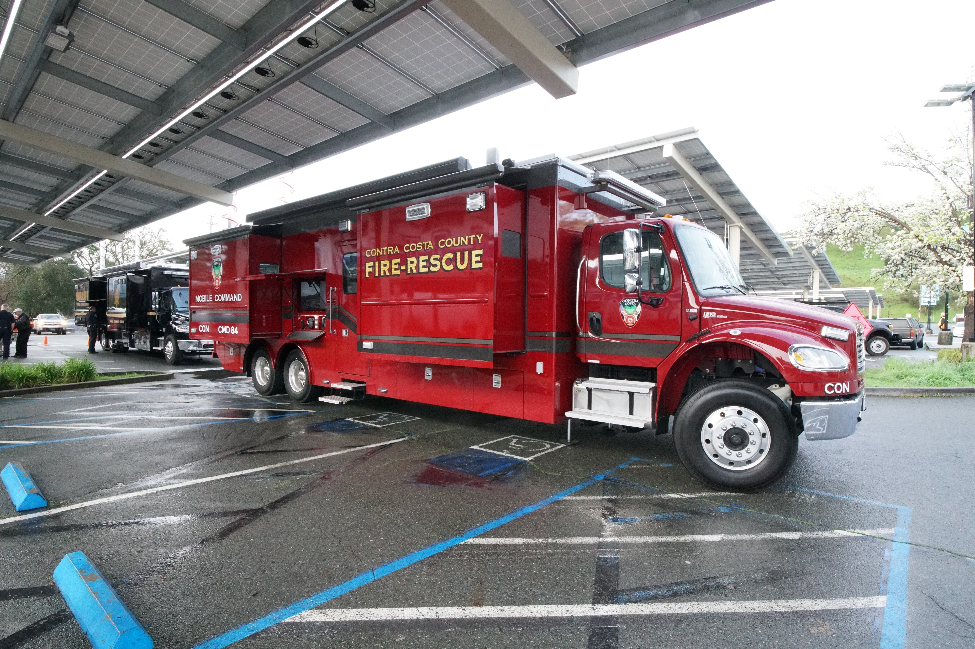
2018 Annual Report
Springhill Evacuation Drill
Over 100 Residents participated, over 200 additional Lafayette residents signed up for the Community Warning System
130 CERT, Fire, Police, Search & Rescue
Ham radio operators….

