Slide 1
Lafayette Police Department - 2020 Annual Report

Slide 2
2020 Annual Report
2020 Part 1 Uniform Crime Reporting (F.B.I. UCR)
Part 1 Category |  | Jan | Feb | Mar | April | May | June | July | Aug | Sep | Oct | Nov | Dec | Totals
1 | Homicide | 0 | 0 | 0 | 0 | 0 | 0 | 0 | 0 | 0 | 0 | 0 | 0 | 0
2 | Rape | 0 | 0 | 0 | 0 | 1 | 0 | 0 | 0 | 0 | 0 | 0 | 0 | 1
3 | Robbery | 1 | 3 | 0 | 1 | 1 | 1 | 0 | 0 | 1 | 1 | 1 | 0 | 10
4 | Assault | 5 | 4 | 2 | 0 | 0 | 2 | 1 | 0 | 0 | 1 | 3 | 1 | 19
5 | Burglary | 2 | 3 | 4 | 5 | 4 | 1 | 4 | 2 | 1 | 2 | 2 | 2 | 32
6 | Larceny | 20 | 23 | 22 | 11 | 17 | 17 | 25 | 19 | 6 | 7 | 19 | 13 | 199
7 | 10851 | 1 | 4 | 6 | 1 | 4 | 0 | 0 | 6 | 1 | 2 | 3 | 2 | 30
8 | Arson | 0 | 0 | 0 | 0 | 0 | 0 | 1 | 0 | 0 | 0 | 0 | 0 | 1
 |  | 29 | 37 | 34 | 18 | 27 | 21 | 31 | 27 | 9 | 13 | 28 | 18 | 292
Reference:
Category 3 – Robbery: Includes robbery with a weapon or by force using hands, fists, etc.
Category 4 – Assault: Includes assaults with weapons and with hands, fists, feet, etc.
Category 5 – Burglary: Includes residential, commercial, and out buildings.
Category 6 – Larceny: Includes all theft, shoplifting, bikes, buildings, etc, expect for theft of a vehicle.

Slide 3
2020 Annual Report
What is Uniform Crime Reporting
The Uniform Crime Reporting (UCR) program is administered by the US Department of Justice through the Federal Bureau of Investigation and collects statistics on the number of known offenses to law enforcement. There are eight Part 1 crimes: Criminal Homicide, Rape, Robbery, Aggravated Assault, Burglary, Motor Vehicle Theft, Larceny, and Arson. The use of UCR also allows anyone to compare crime rates between various cities. Data reported to the UCR can found at https://crime-data-explorer.fr.cloud.gov/

Slide 4
2020 Annual Report
10 Year Comparison of Part 1 Uniform Crime Reporting (F.B.I. UCR)
Part 1 Category |  | 2020 | 2019 | 2018 | 2017 | 2016 | 2015 | 2014 | 2013 | 2012 | 2011
1 | Homicide | 0 | 0 | 0 | 0 | 0 | 0 | 0 | 0 | 0 | 0
2 | Rape | 1 | 1 | 0 | 2 | 5 | 2 | 2 | 0 | 2 | 2
3 | Robbery | 10 | 3 | 5 | 4 | 5 | 5 | 7 | 6 | 7 | 2
4 | Assault | 19 | 16 | 24 | 18 | 25 | 40 | 28 | 37 | 51 | 30
5 | Burglary | 32 | 42 | 23 | 41 | 65 | 49 | 96 | 110 | 101 | 110
6 | Larceny | 199 | 286 | 191 | 257 | 288 | 433 | 324 | 275 | 292 | 251
7 | 10851 | 30 | 30 | 18 | 19 | 41 | 41 | 19 | 28 | 26 | 32
8 | Arson | 1 | 0 | 0 | 1 | 4 | 0 | 0 | 0 | 0 | 0
Yearly Totals |  | 292 | 378 | 261 | 342 | 433 | 570 | 476 | 456 | 479 | 427

Slide 5
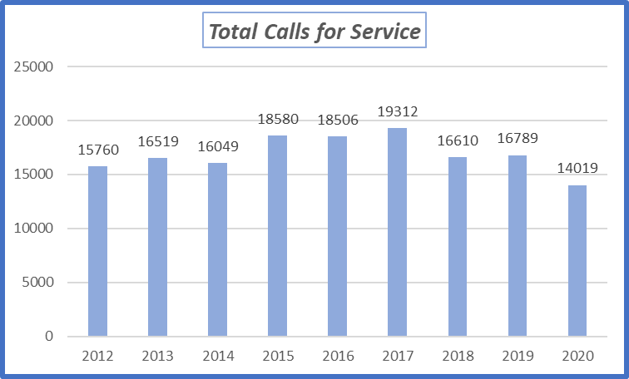
2020 Annual Report

Slide 6
2020 Annual Report
Person Crimes
Crimes against persons are the highest priority as they have the largest impact on the victim.
Lafayette 2019:
1 Assault with Deadly Weapon
11 Robberies
1 Rape
1 Domestic Violence
3 Assaults on Police Officers
(There were no reported child sexual assaults for all of 2020.)

Slide 7
2020 Annual Report
Property Crimes
The largest number of crimes that occur within Lafayette are those that target items of property.
Residential Burglaries
9 Residential Burglaries -
4 Closed

Slide 8
2020 Annual Report
Property Crimes

Slide 9
2020 Annual Report
Property Crimes

Slide 10
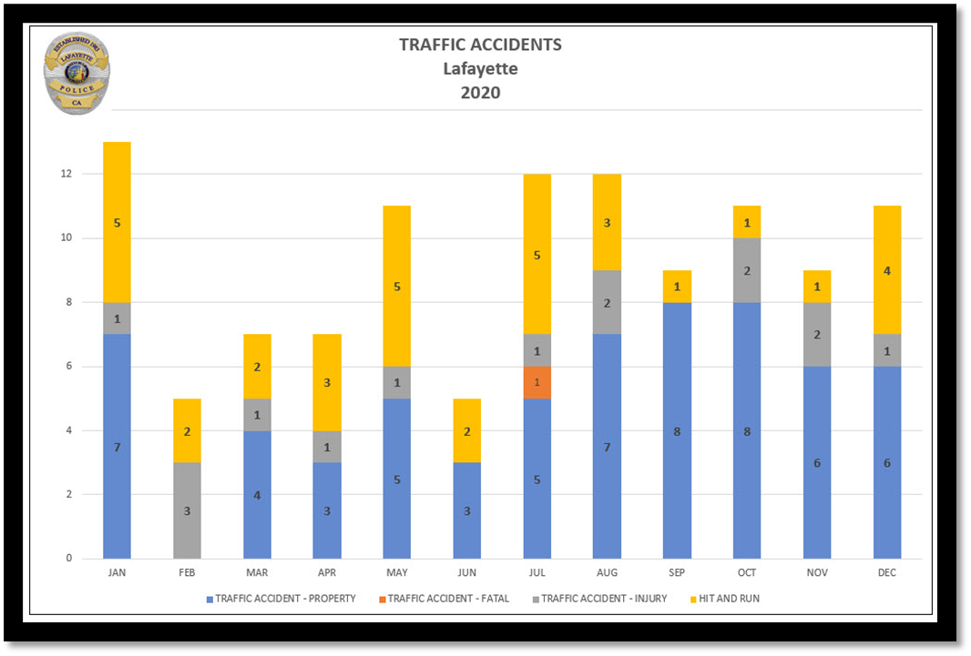
2020 Annual Report
Traffic Collisions 2020

Slide 11
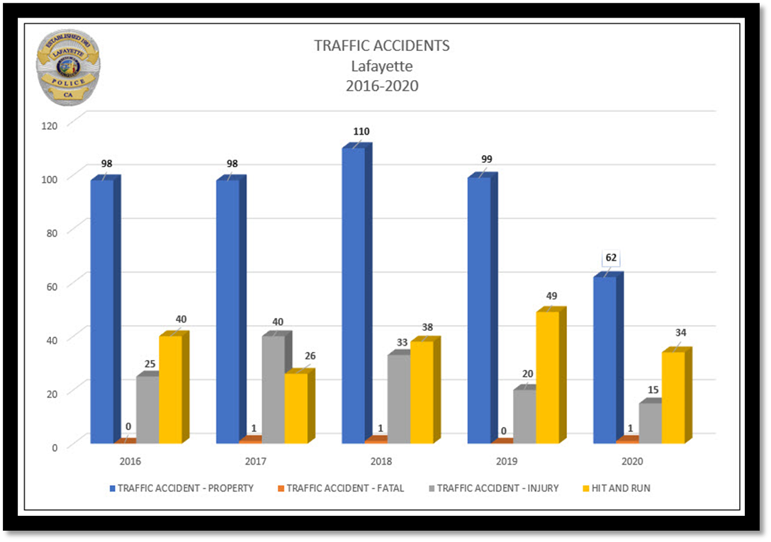
2020 Annual Report
Traffic Collisions 2016 - 2020

Slide 12
2020 Annual Report
Code Enforcement
In Lafayette, the Code Enforcement Unit is within the Lafayette Police Department.
In 2020, the Code Enforcement Unit handled 305 complaints from residents.
The top six calls for service:
Fire hazards & weed abatement
Property Maintenance
Inoperable vehicles and boats in public view
Construction without a permit
Tenant – Landlord – Neighbor disputes
Animals – bees
In 2019, the City Council passed Ordinance 675 which restricted the sale of flavored tobacco products within the City.
The Ordinance also required tobacco retailers to be licensed by the City. Code Enforcement oversaw implementation, licensing and enforcement.
This was accomplished successfully and there are 11 licensed retailers within the City.

Slide 13
2020 Annual Report
Crime Prevention Commission
In 2020, continued the mission of making Lafayette a safe community.
“Lock Up Lafayette”
“Don’t Feed the Bears”
Citizens Academies had to be cancelled due to COVID
Meets Monthly at publicly noticed meetings, a great opportunity for members of the community to engage with the PD

Slide 14
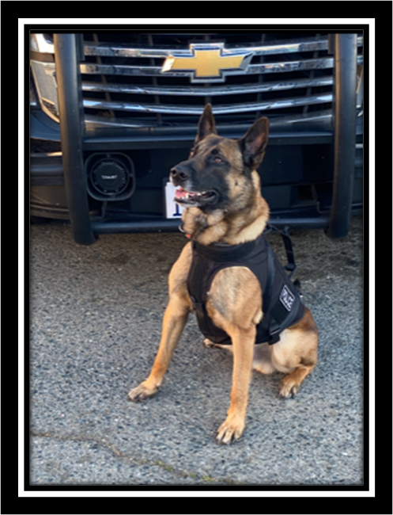
2020 Annual Report
Police Canine Program
In December 2019, Lafayette PD, with funding provided by the Lafayette Police Foundation, purchased a police canine name Rocco.
Rocco completed Patrol Training in January 2020, which involves tracking and apprehension, and is currently working the beat with his handler Officer White.
This year, Officer White and Rocco will be attending a two-month IED Explosives and Firearm school.
When fully trained Rocco will be able to detect over twenty-five scents/chemicals that are involved in the production of explosive devices or are associated with firearms. This capability will greatly enhance public event, religious institution, and school safety within Lafayette.

Slide 15
2020 Annual Report
Emergency Preparedness Commission
In 2020, we continued the mission of prioritizing Lafayette’s emergency plans and preparedness.
Continually review/revise the City of Lafayette’s Emergency Operations Plan
Public Safety Power Shutoffs
Community Warning System (CWS)
ALERTWildfire
Zonehaven
AM1670

Slide 16
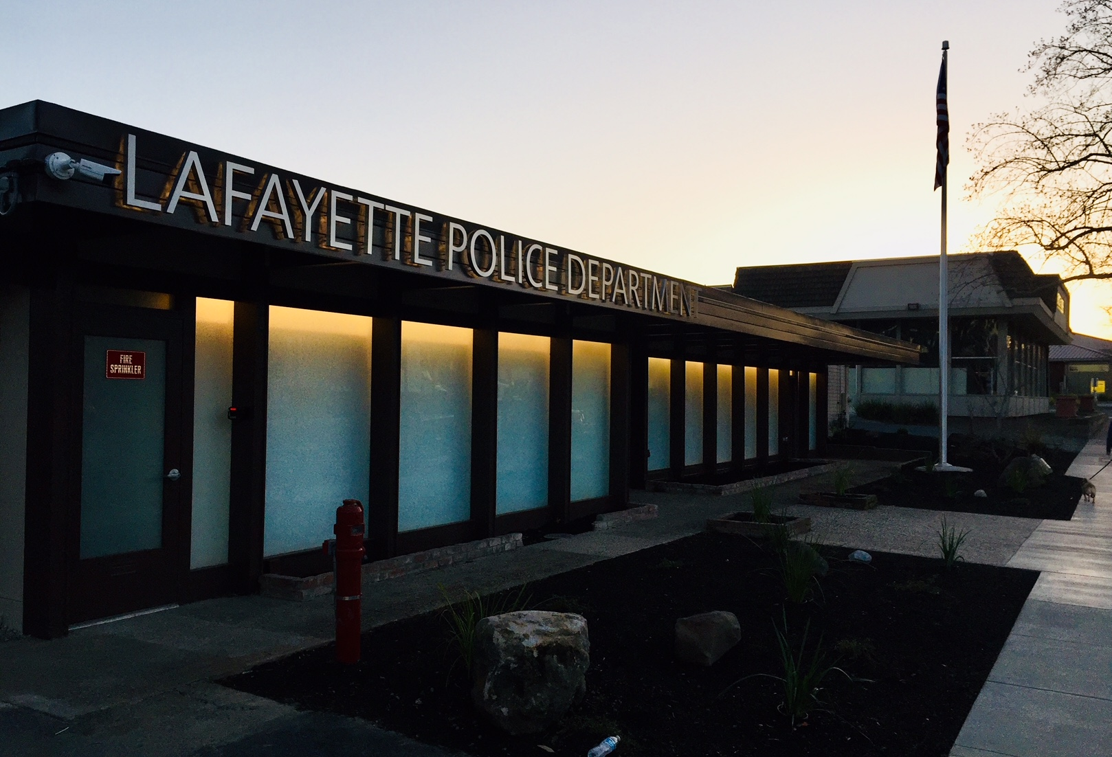
2020 Annual Report
Questions / Comments

