Slide 1
Lafayette Police Department – 2021 Mid-Year Report

Slide 2
2021 Mid-Year Report
2021 Part 1 Uniform Crime Reporting (F.B.I. UCR)
Part 1 Category |  | Jan | Feb | Mar | April | May | June | July | Totals |  | 2020 Year Totals
1 | Homicide | 0 | 0 | 0 | 0 | 0 | 0 | 0 | 0 |  | 0
2 | Rape | 1 | 0 | 0 | 0 | 0 | 0 | 0 | 1 |  | 1
3 | Robbery | 0 | 0 | 1 | 0 | 0 | 0 | 0 | 1 |  | 10
4 | Assault | 1 | 1 | 3 | 5 | 1 | 2 | 2 | 15 |  | 19
5 | Burglary | 1 | 8 | 0 | 2 | 2 | 0 | 0 | 13 |  | 32
6 | Larceny | 17 | 11 | 15 | 15 | 20 | 10 | 12 | 100 |  | 199
7 | 10851 | 1 | 2 | 1 | 1 | 2 | 0 | 3 | 10 |  | 30
8 | Arson | 0 | 0 | 0 | 0 | 0 | 0 | 0 | 0 |  | 1
 |  | 21 | 22 | 20 | 23 | 25 | 12 | 17 | 140 |  | 292
Reference:
Category 3 – Robbery: Includes robbery with a weapon or by force using hands, fists, etc.
Category 4 – Assault: Includes assaults with weapons and with hands, fists, feet, etc.
Category 5 – Burglary: Includes residential, commercial, and out buildings.
Category 6 – Larceny: Includes all theft, shoplifting, bikes, buildings, etc, expect for theft of a vehicle.

Slide 3
2021 Mid-Year Report
10 Year Comparison of Part 1 Uniform Crime Reporting (F.B.I. UCR)
Part 1 Category |  | 2020 | 2019 | 2018 | 2017 | 2016 | 2015 | 2014 | 2013 | 2012 | 2011
1 | Homicide | 0 | 0 | 0 | 0 | 0 | 0 | 0 | 0 | 0 | 0
2 | Rape | 1 | 1 | 0 | 2 | 5 | 2 | 2 | 0 | 2 | 2
3 | Robbery | 10 | 3 | 5 | 4 | 5 | 5 | 7 | 6 | 7 | 2
4 | Assault | 19 | 16 | 24 | 18 | 25 | 40 | 28 | 37 | 51 | 30
5 | Burglary | 32 | 42 | 23 | 41 | 65 | 49 | 96 | 110 | 101 | 110
6 | Larceny | 199 | 286 | 191 | 257 | 288 | 433 | 324 | 275 | 292 | 251
7 | 10851 | 30 | 30 | 18 | 19 | 41 | 41 | 19 | 28 | 26 | 32
8 | Arson | 1 | 0 | 0 | 1 | 4 | 0 | 0 | 0 | 0 | 0
Yearly Totals |  | 292 | 378 | 261 | 342 | 433 | 570 | 476 | 456 | 479 | 427

Slide 4
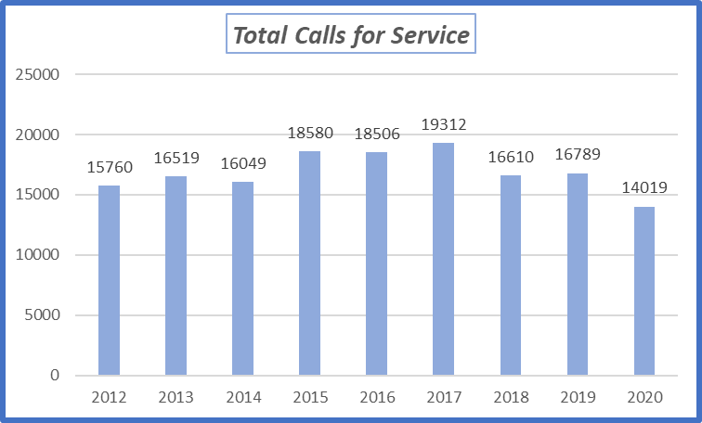
2021 Mid-Year Report
From January to July 2021 Lafayette PD received 7,112 calls for service.

Slide 5
2021 Mid-Year Report
Person Crimes
Crimes against persons are the highest priority as they have the largest impact on the victim.
January to July 2021:
1 Assault with Deadly Weapon (1 total for 2020)
2 Robberies (11 total for 2020)
1 Rape (1 total for 2020)
4 Domestic Violence (1 total for 2020)
(There have been no reported child sexual assaults this year.)

Slide 6
2021 Mid-Year Report
Property Crimes
The largest number of crimes that occur within Lafayette are those that target items of property.
Residential Burglaries
Between January and July
we had 3 Residential
Burglaries

Slide 7
2021 Mid-Year Report
Property Crimes
January to July 2021:
13 Auto Burglaries (42 total for 2020)
5 Grand Theft from Vehicle (11 total for 2020)
16 Petty Theft from Vehicle (43 total for 2020)
14 Commercial Burglary (28 total for 2020)
8 Felony Vandalism (15 total for 2020)
29 Misdemeanor Vandalism (39 total for 2020)

Slide 8
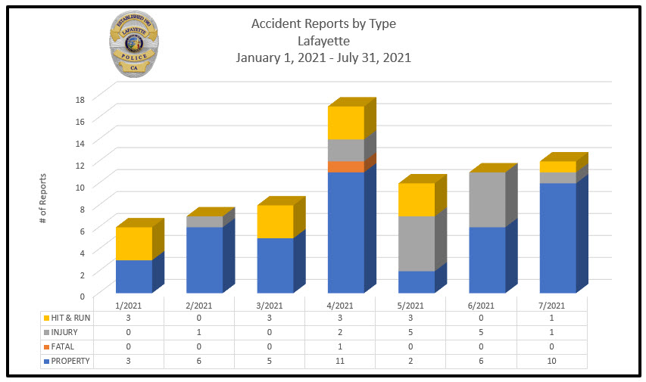
2021 Mid-Year Report
Traffic Collisions Year-to-Date

Slide 9
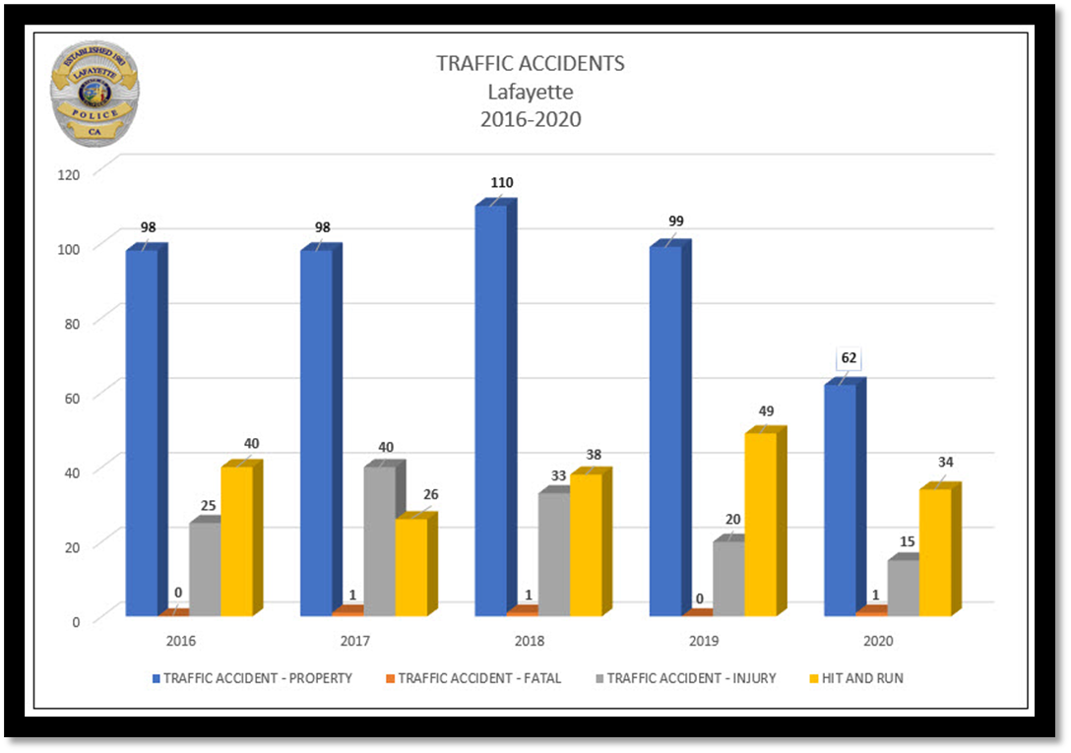
2021 Mid-Year Report
Traffic Collisions 2016 - 2020

Slide 10
2021 Mid-Year Report

Slide 11
2021 Mid-Year Report

Slide 12
2021 Mid-Year Report
CWS tracks sign ups by household. There are approximately 10,000 households in Lafayette.
In February 2019 we had 2,963 signups.
Layette now has over 9,200 signups.
Visit cwsalerts.com to register and learn more!

Slide 13
2021 Mid-Year Report
PSPS – Lafayette PD has begun the process of installing intersection power taps at eight key intersections during a power outage.
Mt. Diablo Blvd and Moraga Blvd
Mt. Diablo Blvd and Oak Hill Rd
Mt. Diablo Blvd and First St
Moraga Blvd and St. Mary’s Rd
Pleasant Hill Blvd and Stanley Rd
Pleasant Hill Blvd and Reliez Valley Rd
Moraga Blvd and Brook St
Pleasant Hill Rd and Springhill Rd

Slide 14
2021 Mid-Year Report
Zonehaven – Zonehaven is a Bay Area technology company and that is working to improve the utilization of evacuation zones in Lamorinda, giving Police and Fire the ability to more effectively evacuate residents during an emergency.
Visit www.community.zonehaven.com to learn more on this ongoing project and the technologies being provided.

Slide 15
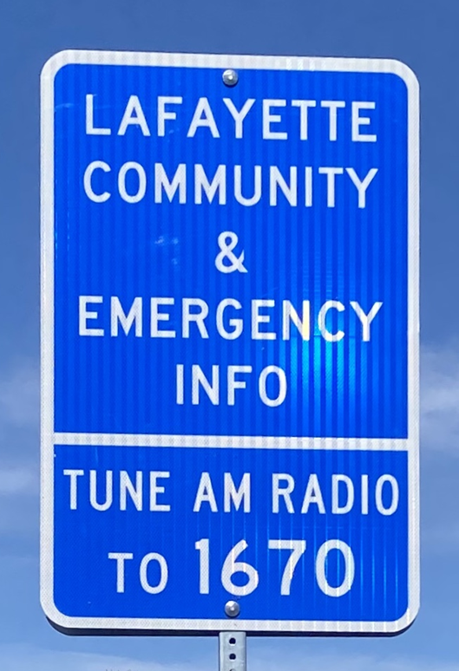
2021 Mid-Year Report
City of Lafayette Emergency Alert AM Radio Station –
AM 1670
The station can provide a range of information for residents, travelers, and the Lamorinda community, the most important of which is emergency information in times of disaster, wildfires, or PG&E power outages.
During non-emergencies, the station carries general city information, including meeting announcements, details on events and programs, and general visitor information about Lafayette.

Slide 16
2021 Mid-Year Report
FY 2020-2021 Cal OES Community Power Resiliency Allocation to Cities Program.
Twenty APX 900 P25 Portable Radios for communication with schools and city emergency workers during power outages and emergencies. These radios will allow the City to provide reliable, real-time information, related to the status of the outage or emergency, and available community resources.
Thirty UHF Digital Mobile Radio Bases for reliable, real-time communication with Lamorinda (Lafayette, Moraga, Orinda) School Buses during power outages and emergencies.

Slide 17
2021 Mid-Year Report
FY 2020-2021 Cal OES Community Power Resiliency Allocation to Cities Program (continued)
Rooftop Mounted Solar System with Resilient Battery Cell and Propane Generator for continued City Public Works and Emergency Preparedness operations during power outages and emergencies.
44Kw Towable Diesel Generator for continued operations at an emergency site within Lafayette.

Slide 18
2021 Mid-Year Report
ALERTWildfire Cameras
In November 2019, the Lafayette Police Dept. began working with the ALERTWildfire program to install and maintain a network of cameras across Contra Costa and Alameda counties to be used for the detection, alerting, and monitoring of wildfires.
As of July 2021, Lafayette PD has installed over 32 ALERTWildfire cameras across both counties for fire-fighting operations.
www.alertwildfire.org
Click on the upper left and select “South & East Bay” to view cameras installed in and around the Lamorinda area.

Slide 19
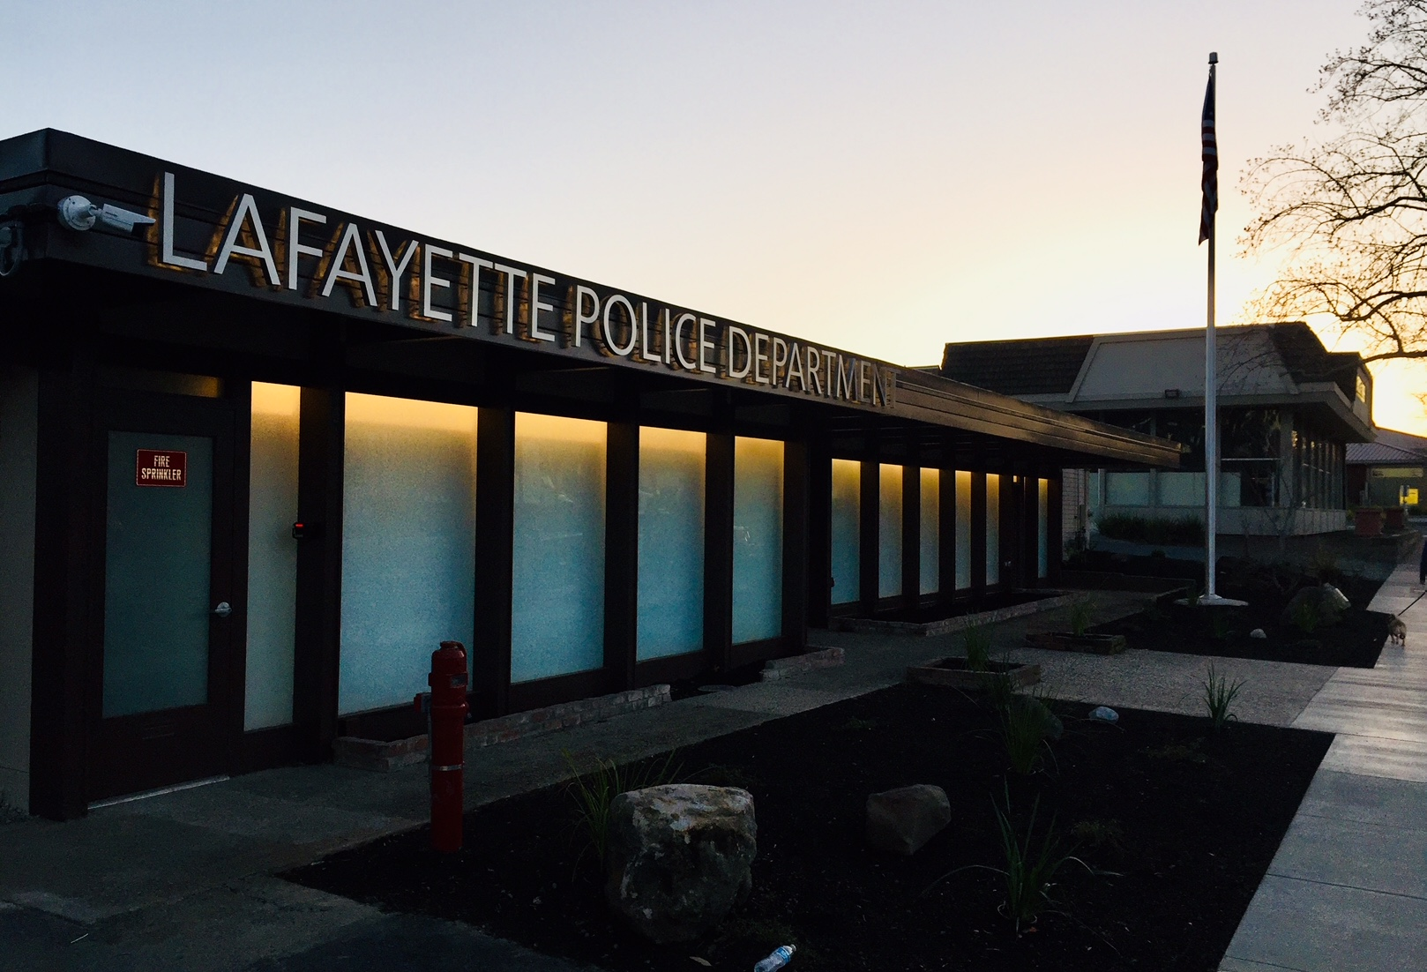
2021 Mid-Year Report
Questions / Comments

