Slide 1
Terraces of Lafayette
Project Update
Notes:
Located at the southwest corner of Deer Hill and Pleasant Hill Roads.

Slide 2
Project Location Map
Notes:
State Highway 4, and Pleasant Hill Road. 22 acre parcel.

Slide 3
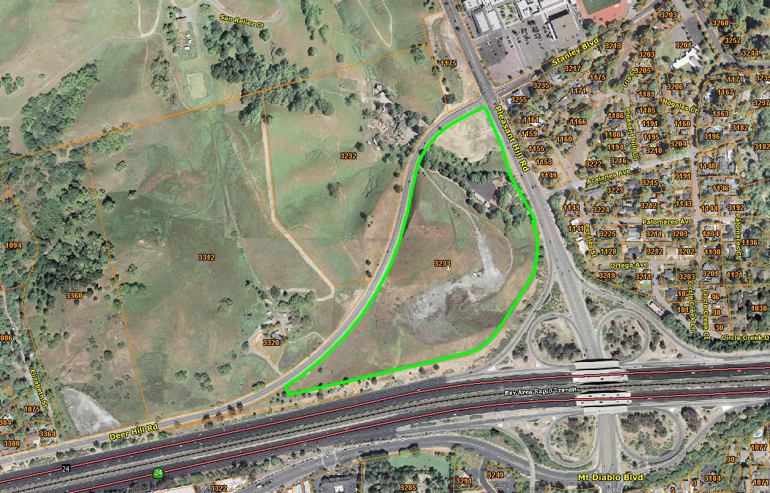
Aerial Photo
Notes:
State Highway 4, Pleasant Hill Road, and Deer Hill Road

Slide 4

Project History
Original – 2011
Alternative - 2013
Terraces of Lafayette
315 moderate-income apartments
Project application deemed complete
Certified Final Environmental Impact Report
No Project decision
Homes at Deer Hill
44 single-family homes
Supplemental EIR
Alternative Process Agreement
Project approved
By referendum decision reversed
Notes:
The Terraces of Lafayette application is a 315 moderate-income apartment Project on a 22-acre parcel. The parcel is zoned APO (Administrative-Professional Office), for professional offices and multifamily residential units, with a density of up to 35 dwelling units per acre. Original Project Deemed Complete: July 5, 2011. FEIR approved Aug 12, 2013. Proposed density:14. du/ac
Hoping to address community concerns about the Project, the City, in December 2013, introduced an alternative known as Homes at Deer Hill (“Project Alternative”). This alternative included 44 single-family homes, a community park with a multi-purpose athletic field, playground, a dog park and a parking lot. A Supplement EIR prepared and certified in September 2015. In 2014, the City and the Developer entered into a Project Alternative Process Agreement suspending the Terraces Project until the Homes at Deer Hill Project Alternative could be reviewed by the City, and it gave the Applicant the right to resume the original Terraces of Lafayette Project.
A Supplemental Environmental Impact Report was prepared and certified, and in September 2015, the City Council approved the Homes at Deer Hill Project Alternative. The General Plan designation for the subject property was changed from Administrative Professional Office (APO) to Low Density Single Family Residential (SFR-LD) by City Council Resolution 2015-51. The Council also adopted Ordinance 641, which, in part, rezoned the property to Single Family Residential District (R-20) and to Planned Unit Development (P1). This resulted in down-zoning of the property from more than 700 units to 44 units. Measure L: reversed approval on June 5, 2018.

Slide 5
Resumed Project – 2018
Project Alternative Process Agreement terminated.
Terraces of Lafayette, Original Project resumed: 315 moderate-income apartments.
Modifications: storm-water and roadway
Applicant-prepared draft Addendum submitted.
Notes:
June 15, 2018 applicant terminated the Alternative Process Agreement and resumed processing the original 2011 Terraces of Lafayette Project, which is currently underway. Applicant prepared draft-Addendum submitted: Dec 18, 2018. The Alternative Process Agreement suspended the Terraces Project until the Project Alternative could be reviewed by the City. Modifications not totally known, do not have a full plan set yet.

Slide 6
When an EIR previously has been prepared for a project and time has passed or project changes have occurred, the lead agency has 3 possibilities for CEQA compliance:
  Rely on prior EIR with no further documentation, other than findings stating that the prior EIR provides adequate CEQA coverage.
  Prepare an Addendum to the prior EIR.
  Prepare a Subsequent or Supplemental EIR.

Slide 7
Public Resources Code Section 21166 and CEQA Guidelines Section 15162 provide that once an EIR has been certified, no subsequent or supplemental EIR shall be prepared for the project unless the lead agency determines, based on substantial evidence, one or more of the following:
  Substantial changes are proposed in the project that will require major revisions of the EIR;
  Substantial changes occur in the circumstances under which the project is being undertaken that will require major revisions in the EIR; or
  New information of substantial importance that was not known and could not have been known at the time the EIR was certified as complete becomes available.

Slide 8
The California Supreme Court has affirmed that: "[o]nce a project has been subject to environmental review and approval, section 21166 and CEQA Guidelines section 15162 limit the circumstances under which [an SEIR] must be prepared." Friends of the College of San Mateo Gardens v. San Mateo County Community College Dist., 1 Cal. 5th 937 (2016).
  Another recent case, Save Our Heritage Organization v. City of San Diego (Oct. 24, 2018), explained that "Section 21166 effectively creates a presumption against further environmental review after a project has been previously subjected to environmental review. "

Slide 9
A change in the circumstances under which a project is being undertaken requires preparation of an SEIR only if all four of the following conditions are found to exist
  The change in circumstances is substantial;
  The change involves new or a substantial increase in the severity of significant environmental impacts;
  The change will require major revisions based on the new or more severe impacts;
  The impacts were not covered in the previous EIR.
  The focus of the inquiry is not on the nature, scope, or extent of the changed circumstances, but on whether they would result in new significant project impacts.

Slide 10
New information, which was not known and could not have been known at the time the EIR was certified requires an SEIR only if it shows that:
  The project will have significant effects not evaluated in the prior EIR;
  Significant effects previously examined will be substantially more severe; or
  Mitigation measures or alternatives considerably different from those analyzed in the EIR, or which were previously found infeasible, but which are in fact feasible, would substantially reduce significant effects, but the project sponsor declines to adopt them.

Slide 11
An Addendum must be prepared if there are some necessary changes or additions to the prior EIR, but none of the conditions described in Sections 21166 or 15162 calling for preparation of an SEIR have occurred. (CEQA Guidelines § 15164(a)).

Slide 12
City Addendum Review
Impact Sciences, pre-approved consultant, conducted adequacy review.
No substantial project changes or changed circumstances, Addendum rather then Supplemental EIR appropriate.
Applicant-prepared draft Addendum inadequate requiring substantial revisions and additional technical analysis.
Notes:
Impact Sciences Scope: 1) appropriate level of CEQA document for the Project (Addendum/SEIR); 2) Addendum adequate to meet CEQA requirements; 3) identify deficiencies and areas of further work or analysis.
Next Step Addendum:
New or significant revisions to technical studies to analyze Project impacts: transportation, air quality, noise impacts, potentially greenhouse gas impacts.
Some conclusions not accompanied by sufficient evidence or justification.
Additional information required: demolition and removal of asbestos and lead-based paint, cultural resources impacts, salvaging of blue wildrye. Updated info on population, housing, energy, and wildfire risks. See Impact Sciences memo for detail.
Issues previously analyzed and conclusions drawn from the certified Final EIR, with respect to impacts, including aesthetic and land use, if not changed by the Project will not be considered.
Regarding CEQA: If further analysis reveals unanticipated new or substantially more severe significant impacts, City staff will reexamine whether an Addendum or SEIR appropriate.
Rob Hodil, Cities Land Use Attorney and our counsel on this project from Coblentz, Patch, Duffy & Bass on appropriate level of CEQA document for the Project.

Slide 13
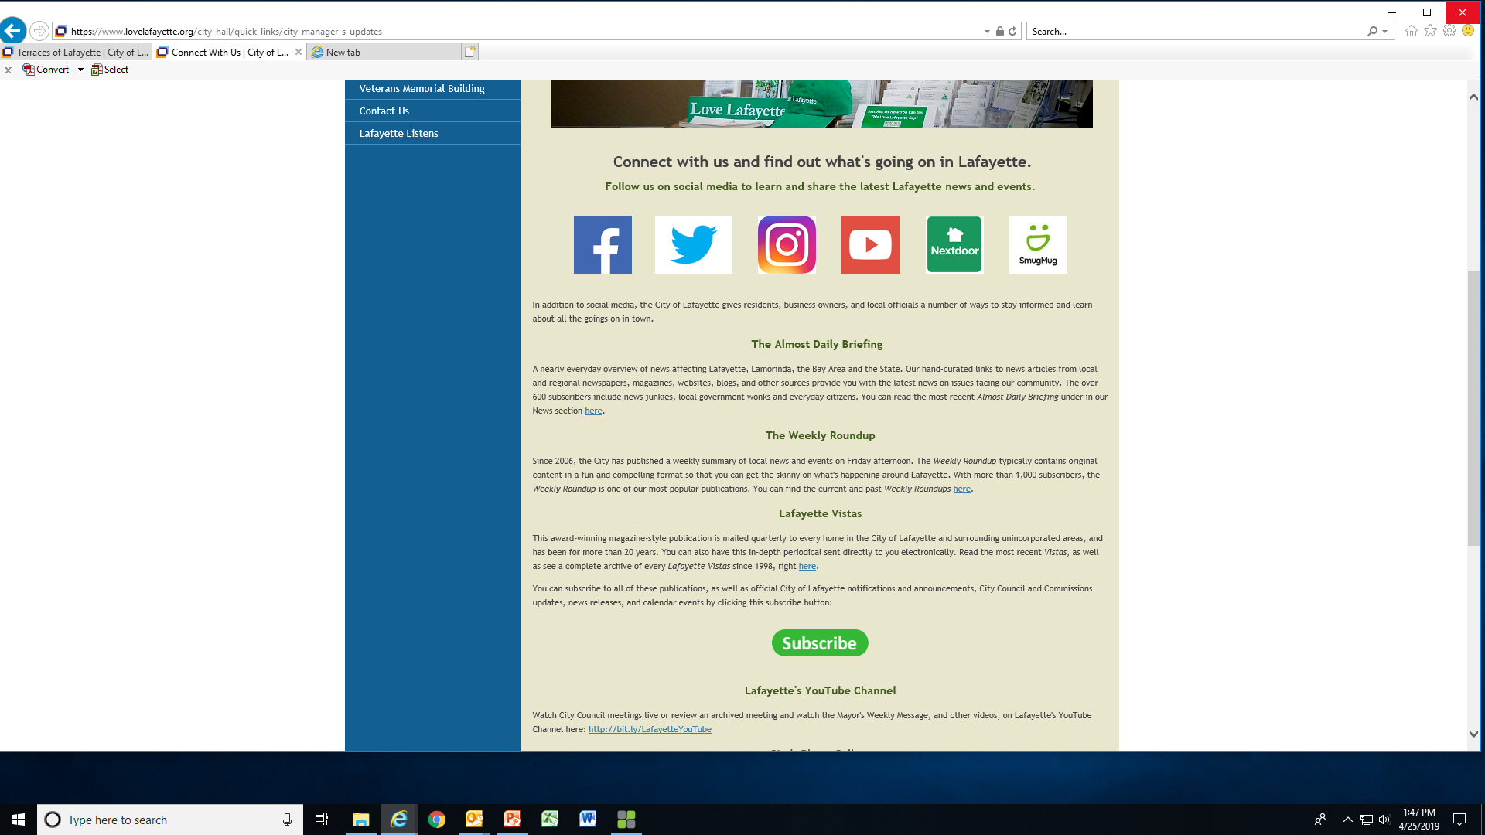
Staying Informed
Notes:
Home page “Connect with Us”, subscribe on the far right side of the page is a “Terraces of Lafayette” project. Receive information.

Slide 14
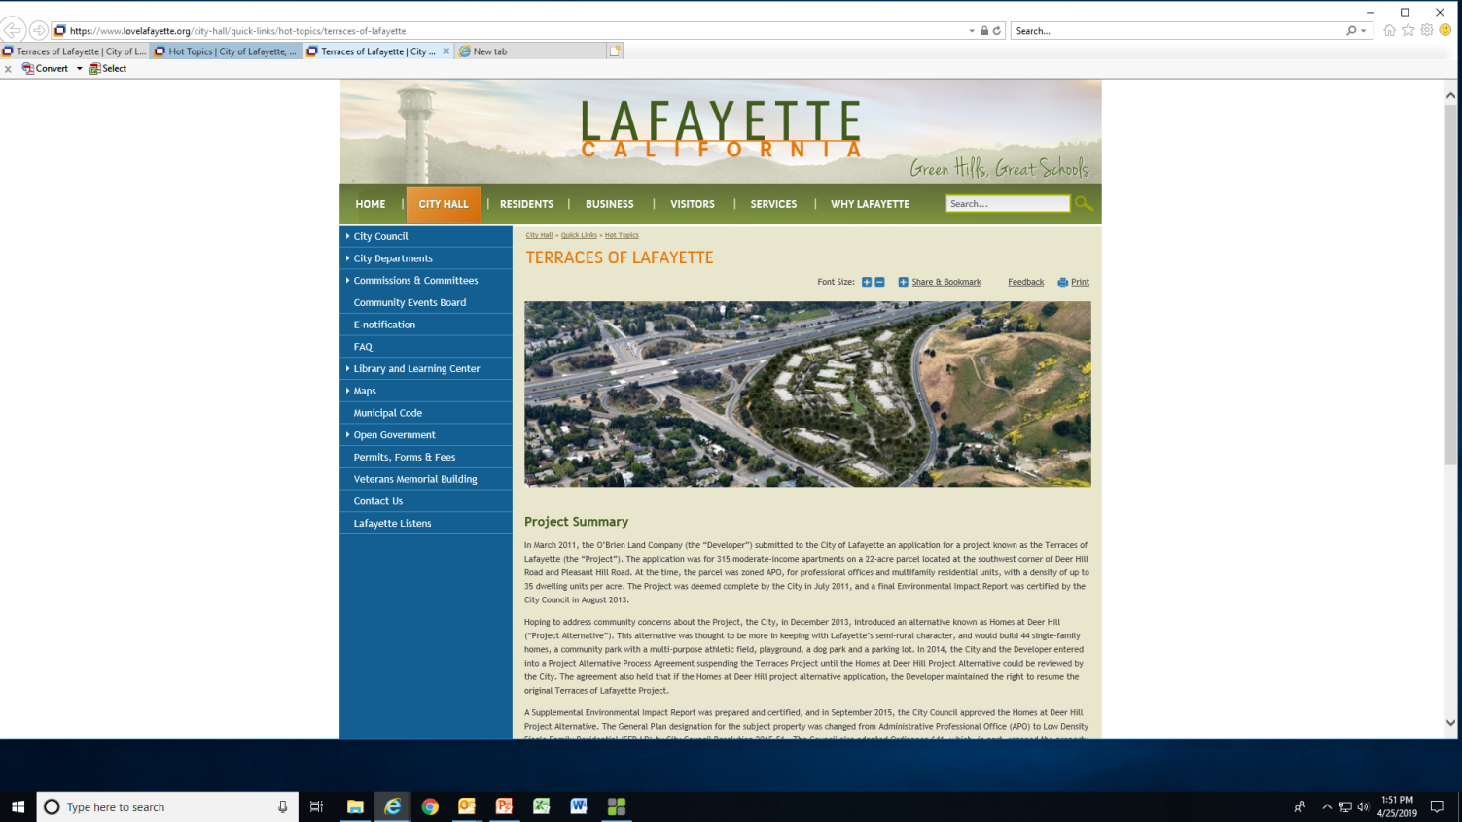
Dedicated Project Page www.lovelafayette.org/terraces
Notes:
Dedicated Project Page on the website where all current information is posted.

Slide 15
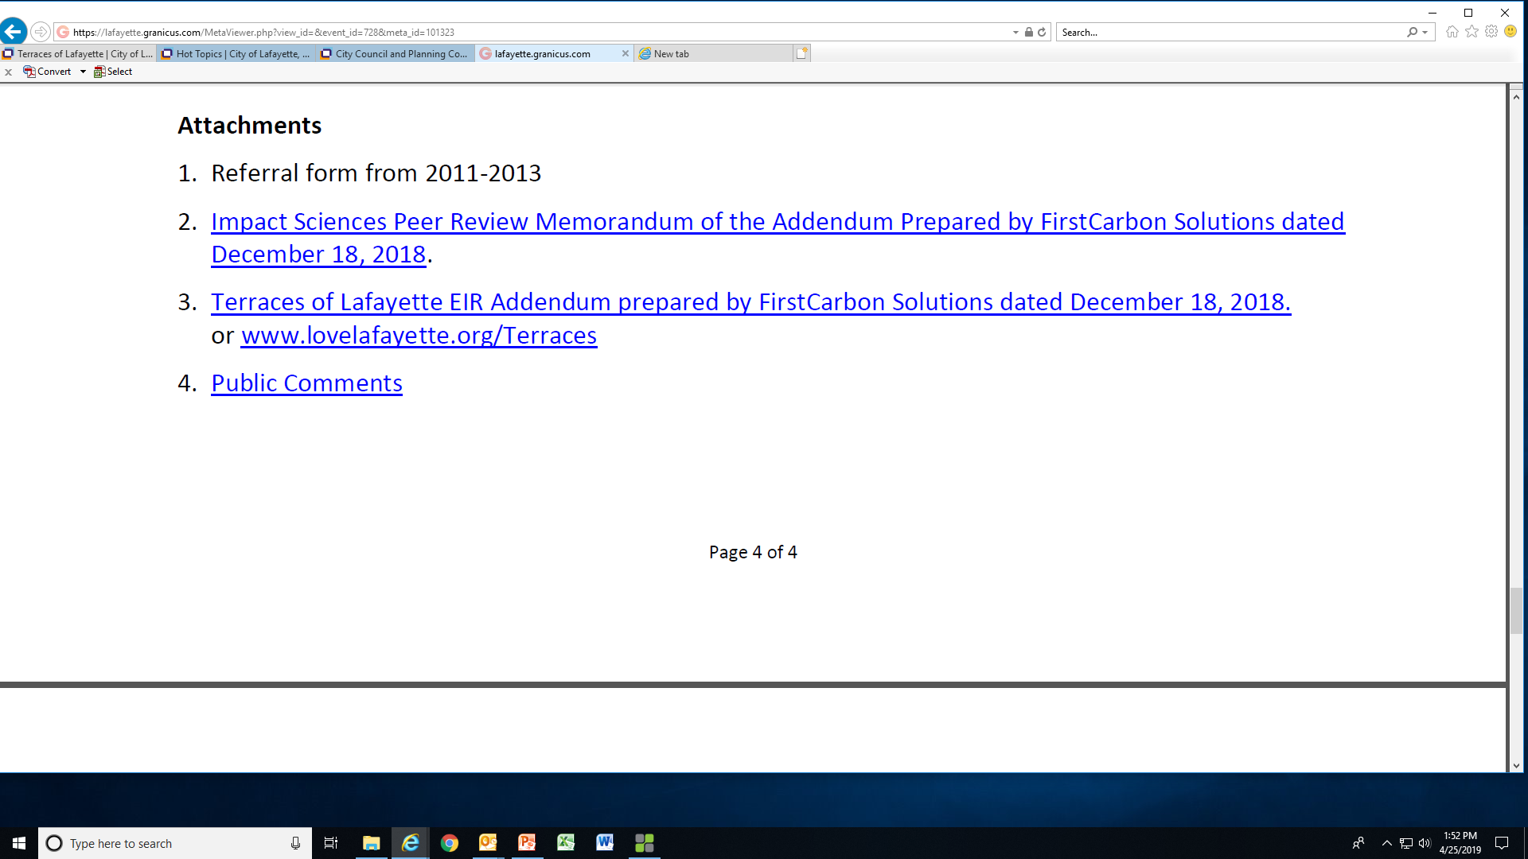
Public Notice & Comments
Notes:
For today’s meeting we noticed all property owners within 500’, Daily Briefing, Weekly Roundup, e-notification, website, social medial.
There is a live link in the e-government staff report to all comments received. We are working on making this live link available directly on the Dedicated Project Page.

Slide 16

Recommendation
Questions of staff.
Applicant presentation (including proposed changes).
Public comment period.
Applicant rebuttal period.
PC - Refer Project to the Transportation & Circulation Commission.
CC - Direct staff to proceed with hiring Impact Sciences to prepare the Addendum for the Project.
Notes:
First Carbon Solutions is the consultant hired by the applicant to prepare the draft Addendum. They are not on the City approved CEQA consultant list. Staff would like to proceed with reviewing a scope of work from Impact Sciences, a city approved CEQA consultant, and hire them to complete the Addendum. This is to ensure the City has oversight and manages the process and exercises its independent judgement in preparing the Addendum.
The completion of the Addendum will take 3-6 months. Take Project to the Transportation & Circulation Commission. Return to Planning Commission for public hearing on CEQA determination, Design Review Permit, Ridgeline Exception, Hillside Permit, Grading Permit, and Tree Removal Permit.

