Slide 1
Economic Development
A Toolkit by the Economic Develop-Mentors
2017 Contra Costa County Local Government Leadership Academy

Slide 2
THE TEAM:
LaTanya Fisher, CITY OF SAN PABLO
Jonathan Katayangi, CITY OF LAFAYETTE
Michelle Parella, CONTRA COSTA COUNTY
Liz Payne, CITY OF WALNUT CREEK
Dario Sanchez, CITY OF CONCORD
Felix Tan, CITY OF RICHMOND
Sheena Wellman-Miner, CITY OF ORINDA
SPONSOR:
Steven Falk, City Manager
CITY OF LAFAYETTE

Slide 3
REDEVLOPMENT THE RESTAURATEUR WAY

Slide 6
EMBRACE YOUR BRAND
STEP 1
Identify what makes your city unique
Channel this into a marketing strategy
Integrate your brand into your plans
Communicate and advertise your brand
THE CITY OF PRIDE & PURPOSE
Notes:
See notes with 4 points

Slide 8
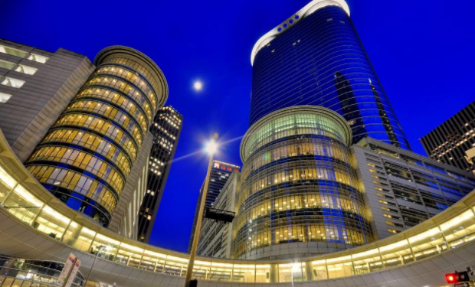
AMERICA’S NEXT
GREAT CITY
CHOOSE YOUR CHEF & BUILD YOUR TEAM
STEP 2
Who is your Executive Chef?
Build your Brigade
Team knowledge

Slide 9
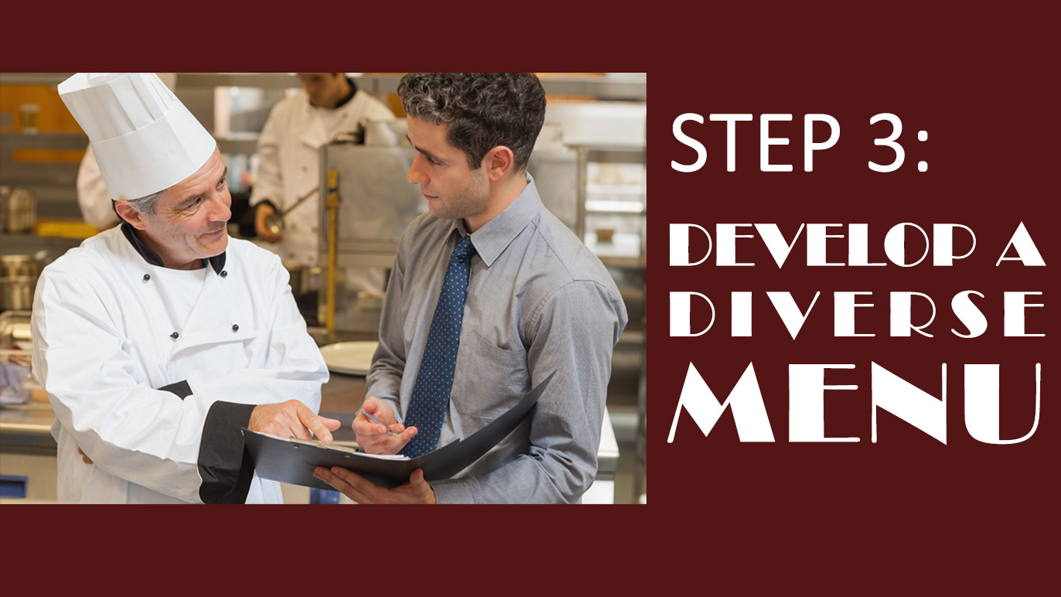

Slide 10
DEVELOP A DIVERSE MENU
STEP 3
Neighborhood Improvements
Business Improvements
New Developments
(Housing & Business)

Slide 11
EXAMPLE
Promote Increased Sense of Individual and Community Pride - Neighborhood
Create a Strong Business Community that Supports Local Government – Business Improvement
Encourage Live, Work and Play within the Community – Housing & New Business Development

Slide 14
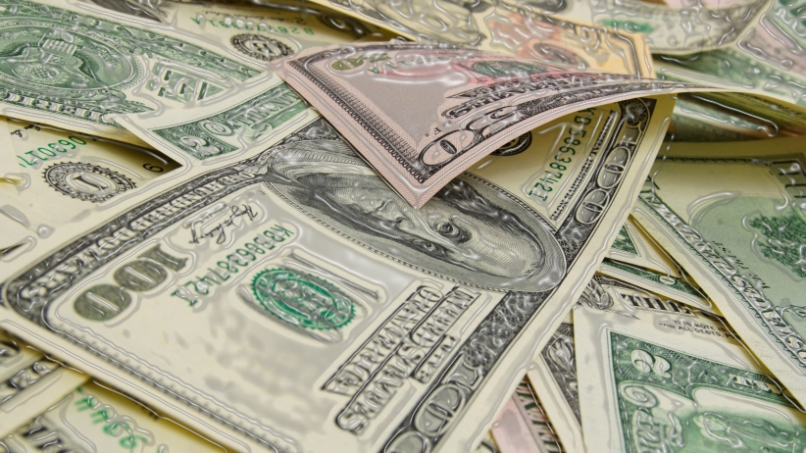
EXCITE INVESTORS / CREATIVE FUNDING
STEP 4
Assessment, Improvement & Finance Districts
PROPERTY BASED IMPROVEMENT DISTRICTS (PBID’s)
COMMUNITY FACILITIES DISTRICTS (CFD’s)
ENHANCED INFRASTRUCTURE FINANCE DISTRICTS (EIFD)
GENERAL FUND
TAXES AND FEES
STATE / FEDERAL GRANTS
Notes:
Remove green box on left. Keep the right side.

Slide 16
Four Steps to Success
FOUR STEPS TO SUCCESS
Step 1 Embrace your Brand
Step 2 Choose your Chef & Build your Team
Step 3 Develop a Diverse Menu that will Attract the Clientele
Step 4 Excite Investors & Look for Creative Financing Opportunities

Slide 17
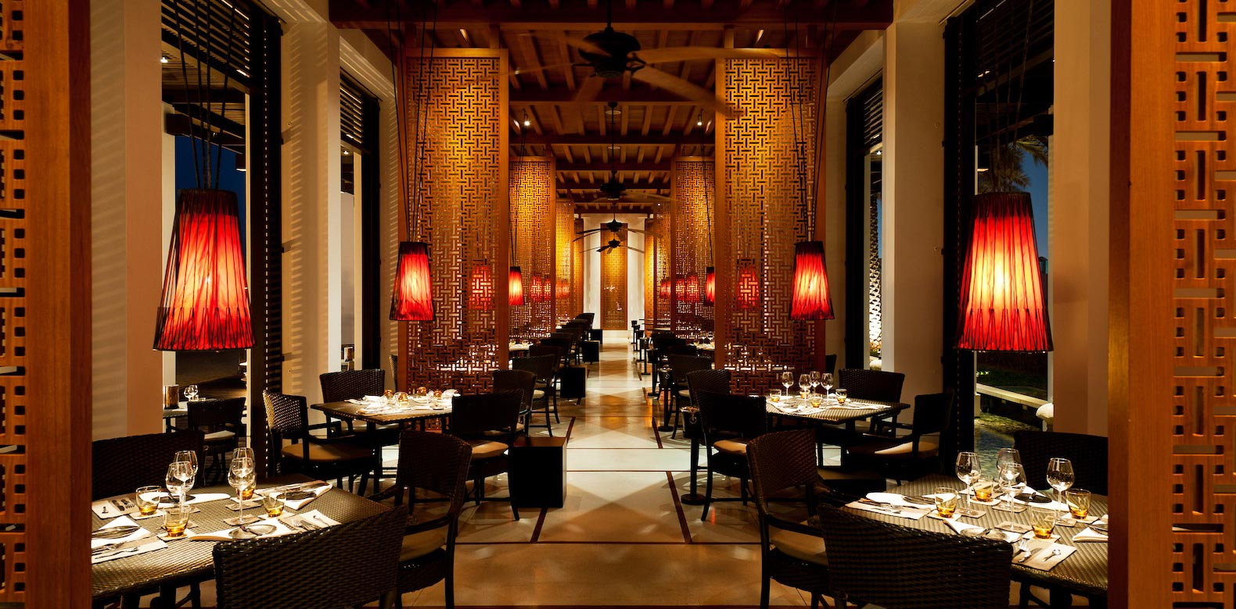
MAKE YOUR CITY THE PLACE TO BE

